Slide 1
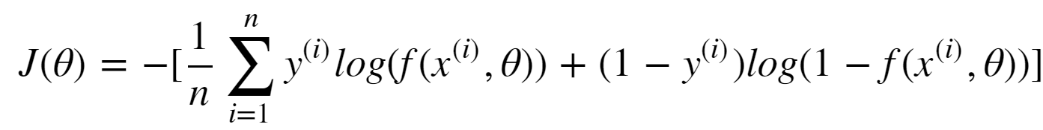
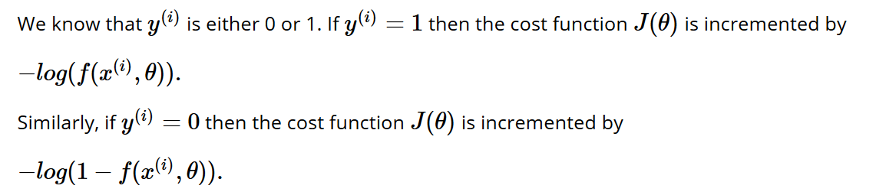

logistic regression: cost (loss function)
Machine Learning Methods for Biomedical Data (D012554)

Slide 2
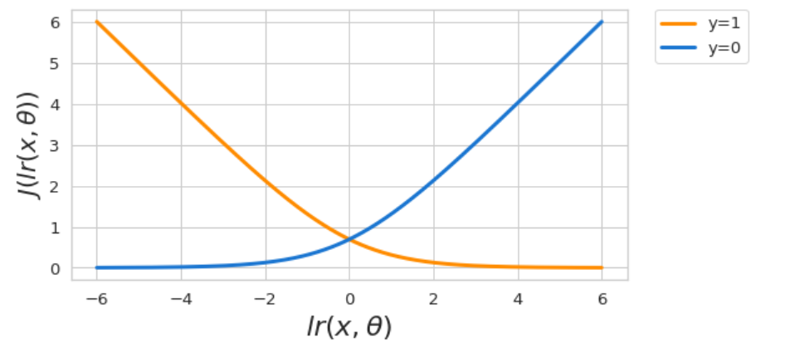
logistic regression: cost (loss function)
Machine Learning Methods for Biomedical Data (D012554)

Slide 3
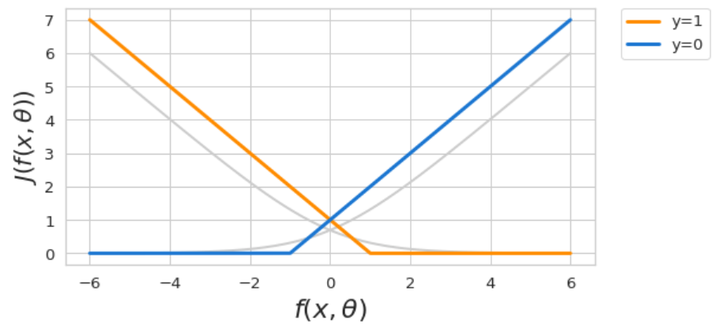
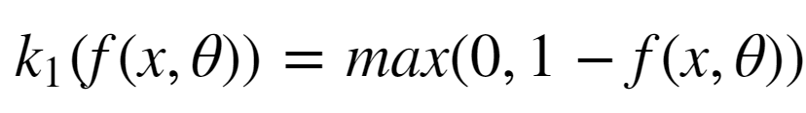
Support vector machine: cost (loss function)
replace cost function by piecewise linear function
if y = 1 then the contribution to the cost is
Machine Learning Methods for Biomedical Data (D012554)

Slide 4
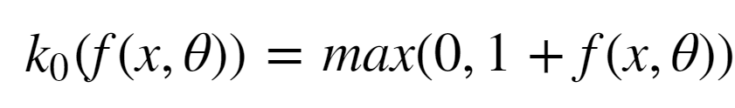
Support vector machine: cost (loss function)
replace cost function by piecewise linear function
if y = 0 then the contribution to the cost is
Machine Learning Methods for Biomedical Data (D012554)

Slide 5
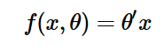
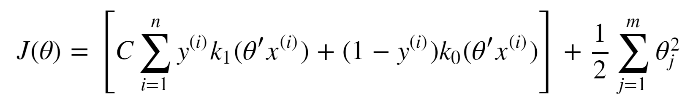
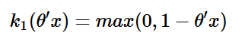
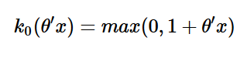
Support vector machine: cost (loss function)
Fit a linear model
such that
with and
is minimized.
Machine Learning Methods for Biomedical Data (D012554)

Slide 6
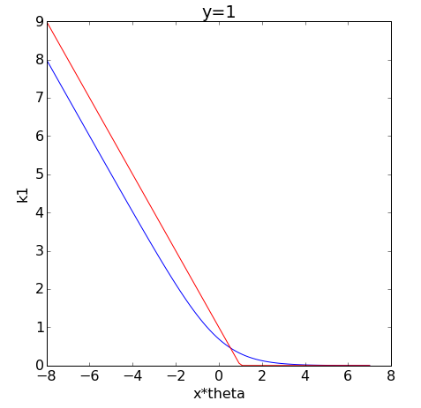
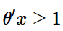
Support vector machine: cost (loss function)
In this case the contribution to the cost needs to be small when the model predicts high values (>0) and large when the model predicts low values (<0).
For SVMs we see that the contribution to cost decreases linearly and becomes zero when
Machine Learning Methods for Biomedical Data (D012554)

Slide 7
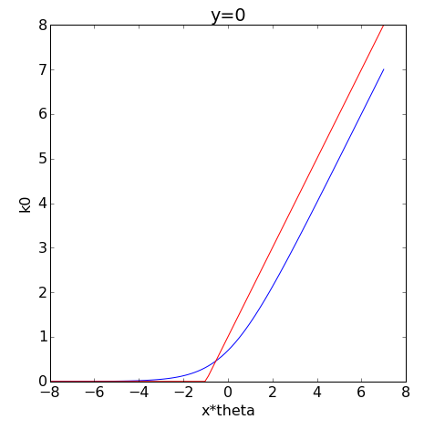
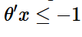
Support vector machine: cost (loss function)
In this case the contribution to the cost needs to be large when the model predicts high values (>0) and small when the model predicts low values (<0).
For SVMs we see that the contribution to the cost is zero for
and then increases linearly.
Machine Learning Methods for Biomedical Data (D012554)

Slide 8
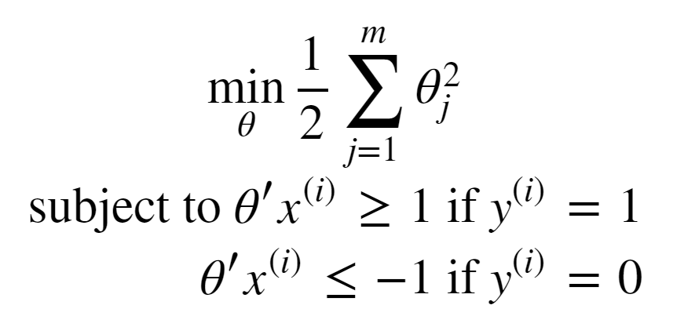
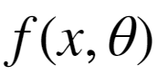
Support vector machine: cost (loss function)
Consider a train set with two classes that are perfectly linearly separable.
The piecewise cost function can be made zero.
The SVM objective can be written as
Machine Learning Methods for Biomedical Data (D012554)

Slide 9
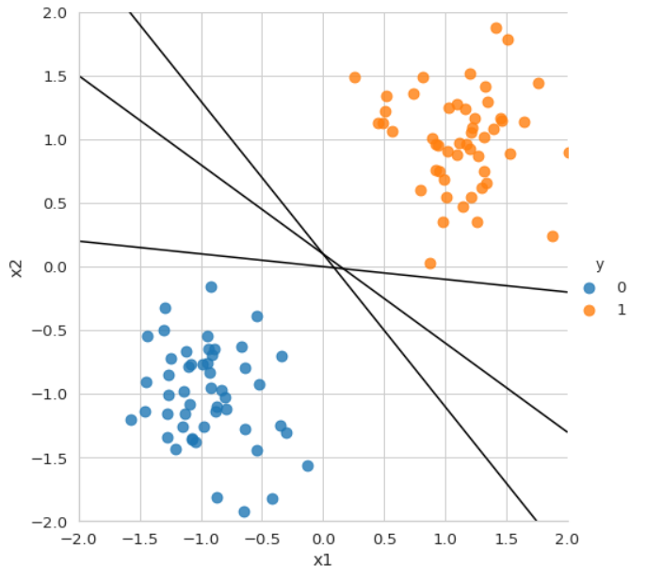
Machine Learning Methods for Biomedical Data (D012554)

Slide 10
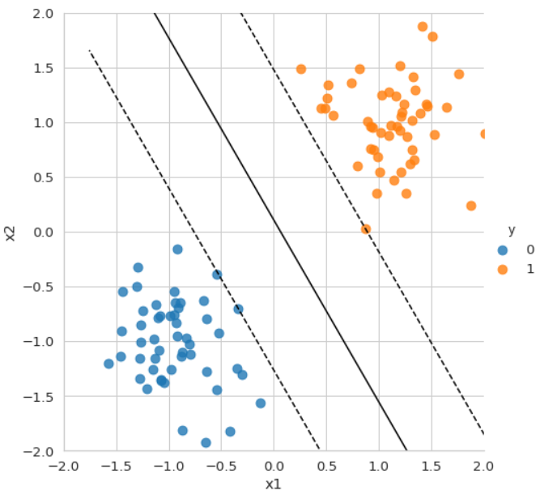
Machine Learning Methods for Biomedical Data (D012554)

Slide 11
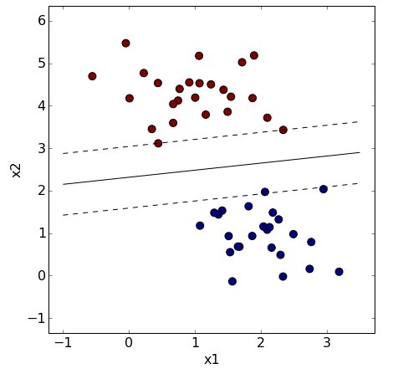
Support vector machine: large margin classifier
Machine Learning Methods for Biomedical Data (D012554)

Slide 12
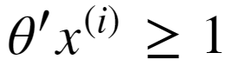
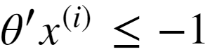
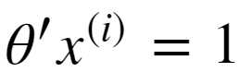
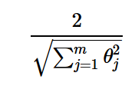
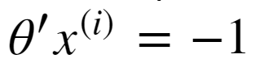
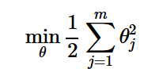
Support vector machine: large margin classifier
red points statisfy
blue points satisfy
distance bewteen two dashed lines is
SVM objective was
Machine Learning Methods for Biomedical Data (D012554)

Slide 13
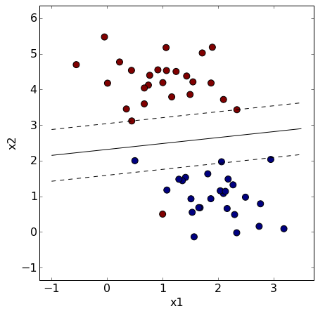
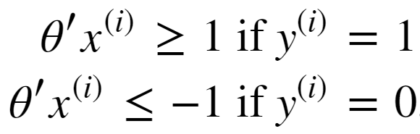
Support vector machine: soft margin
Machine Learning Methods for Biomedical Data (D012554)

Slide 14
Support vector machine: soft margin
Machine Learning Methods for Biomedical Data (D012554)

Slide 15
Support vector machine: soft margin
Machine Learning Methods for Biomedical Data (D012554)

Slide 16
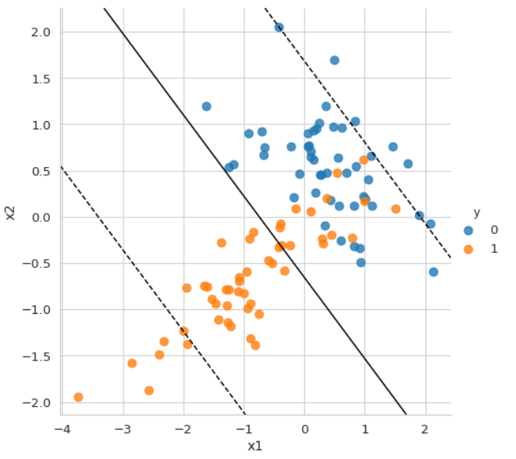
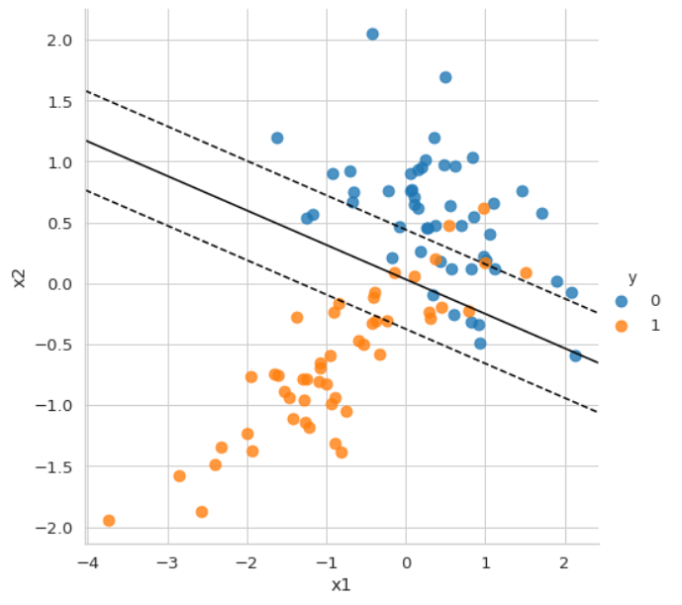
Support vector machine: regularization hyperparameter
Machine Learning Methods for Biomedical Data (D012554)

Slide 17
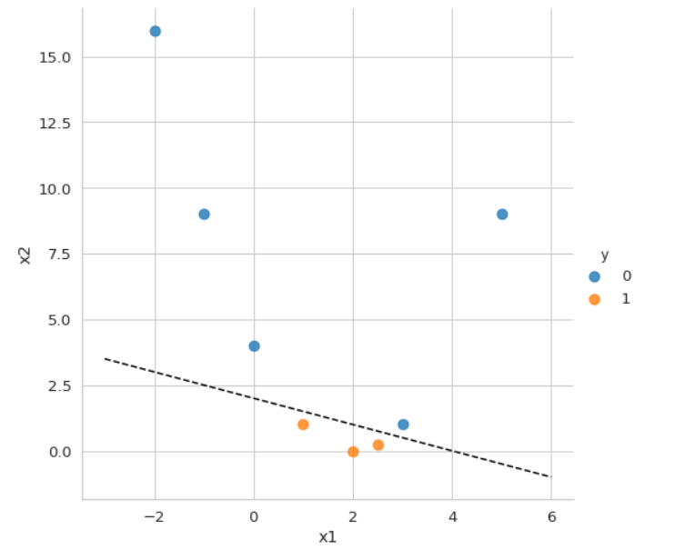
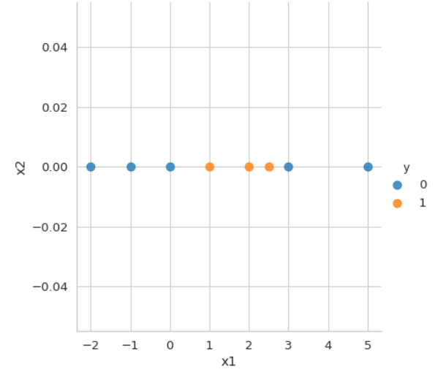
Support vector machine: kernels
Machine Learning Methods for Biomedical Data (D012554)

Slide 18
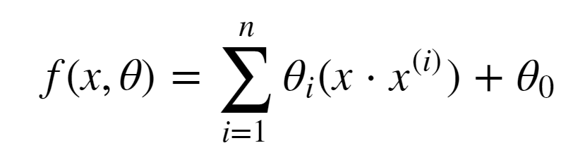
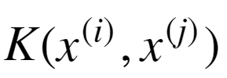
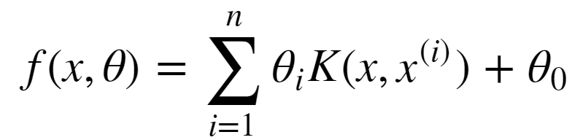
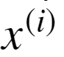
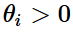
Support vector machine: kernels
SVMs can also be formulated as a linear function of the samples (dual form) instead of the features as
that can be reformulated as a non-linear function using what is known as a kernel function
to become
The data points for which are called the support vectors.
Machine Learning Methods for Biomedical Data (D012554)

Slide 19
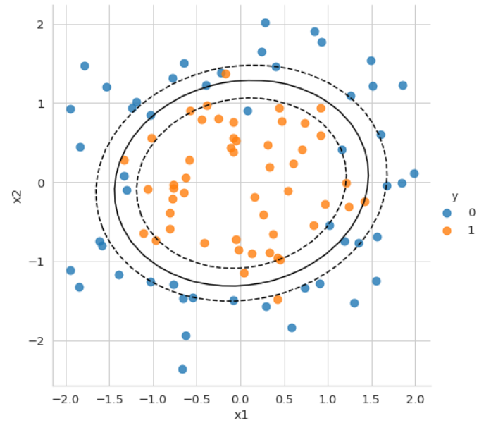
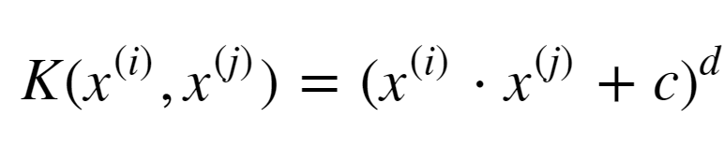
Support vector machine: polynomial kernel
Machine Learning Methods for Biomedical Data (D012554)

Slide 20

Support vector machine: polynomial kernel
Machine Learning Methods for Biomedical Data (D012554)

Slide 21
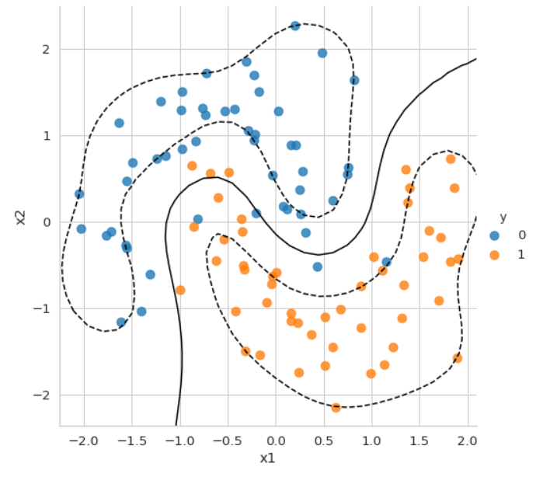
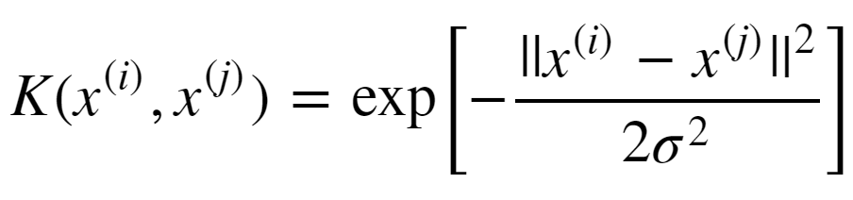
Support vector machine: RBF kernel
Machine Learning Methods for Biomedical Data (D012554)

Slide 22
Support vector machine: kernels
Machine Learning Methods for Biomedical Data (D012554)

